Slide 1
AI-Powered Credit Scoring and Document OCR System for Loan Risk Assessment
CO-OP Project at Industry (Module-2) | Project Type: Copyright
Team: Om Tomar, Sahajpal Singh, Ridhima Chopra, Ishpreet Kaur
Supervisor/Mentor: Lalit Sharma
Best German Credit ROC-AUC
Best Lending ROC-AUC
Synthetic OCR Accuracy
0.831
0.722
91.5%

Slide 2
Problem Statement
Reliable digital lending needs risk prediction and document understanding.
Manual document checks slow loan onboarding and increase operational cost.
Credit-risk models must detect risky borrowers while staying explainable.
A GitHub-verifiable package is needed for evaluation, reproducibility, and IPR readiness.
Goal
End-to-end AI workflow for loan risk assessment
Output
Runnable source code + report + PPT + IPR placeholder
Evaluation
Metrics, plots, reproducible configs

Slide 3
Objectives
Build a reproducible credit-scoring benchmark on public datasets.
Compare Logistic Regression, Random Forest, Gradient Boosting, and MLP.
Save traceable metrics, plots, confusion matrices, and feature importance.
Demonstrate PaddleOCR fine-tuning value through labeled synthetic benchmarking.
Package the repository according to final evaluation instructions.

Slide 4
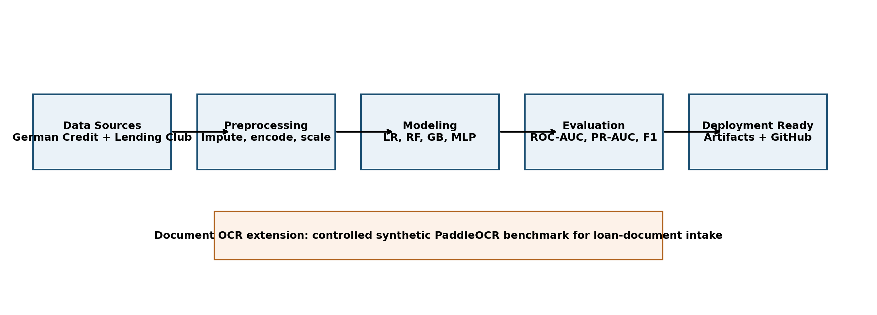
System Architecture
Credit scoring is the core decision pipeline. OCR is the document-intake extension for borrower forms.

Slide 5
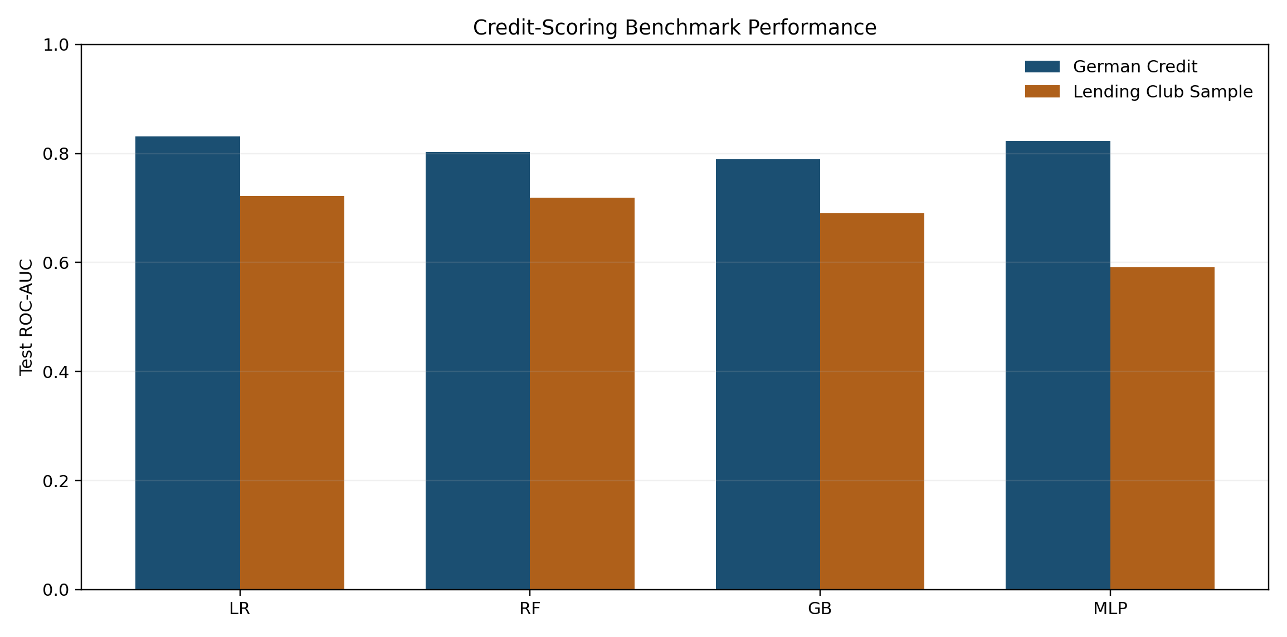
Credit-Scoring Experiment Design
Datasets: German Credit and Lending Club sample.
Preprocessing: imputation, one-hot encoding, scaling, class weighting, oversampling.
Metrics: ROC-AUC, PR-AUC, precision, recall, F1, accuracy, confusion matrix.
Explainability: feature-importance CSV and plot saved for every run.

Slide 6
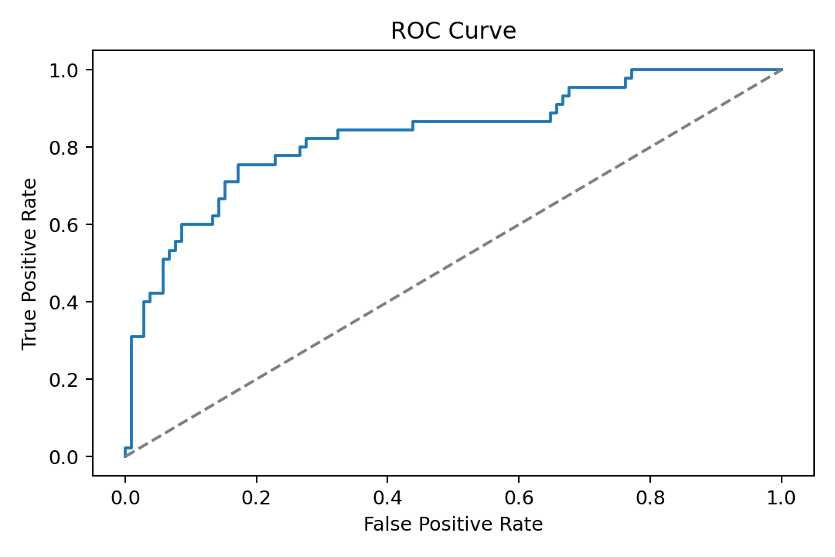
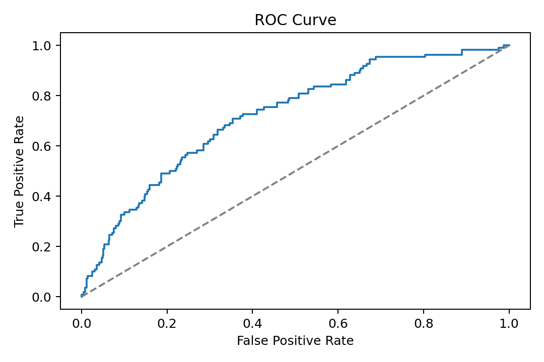
Best Credit-Scoring Results
German Credit
Lending Club Sample
Logistic Regression ROC-AUC 0.831 Recall 0.778
Logistic Regression ROC-AUC 0.722 Recall 0.682

Slide 7
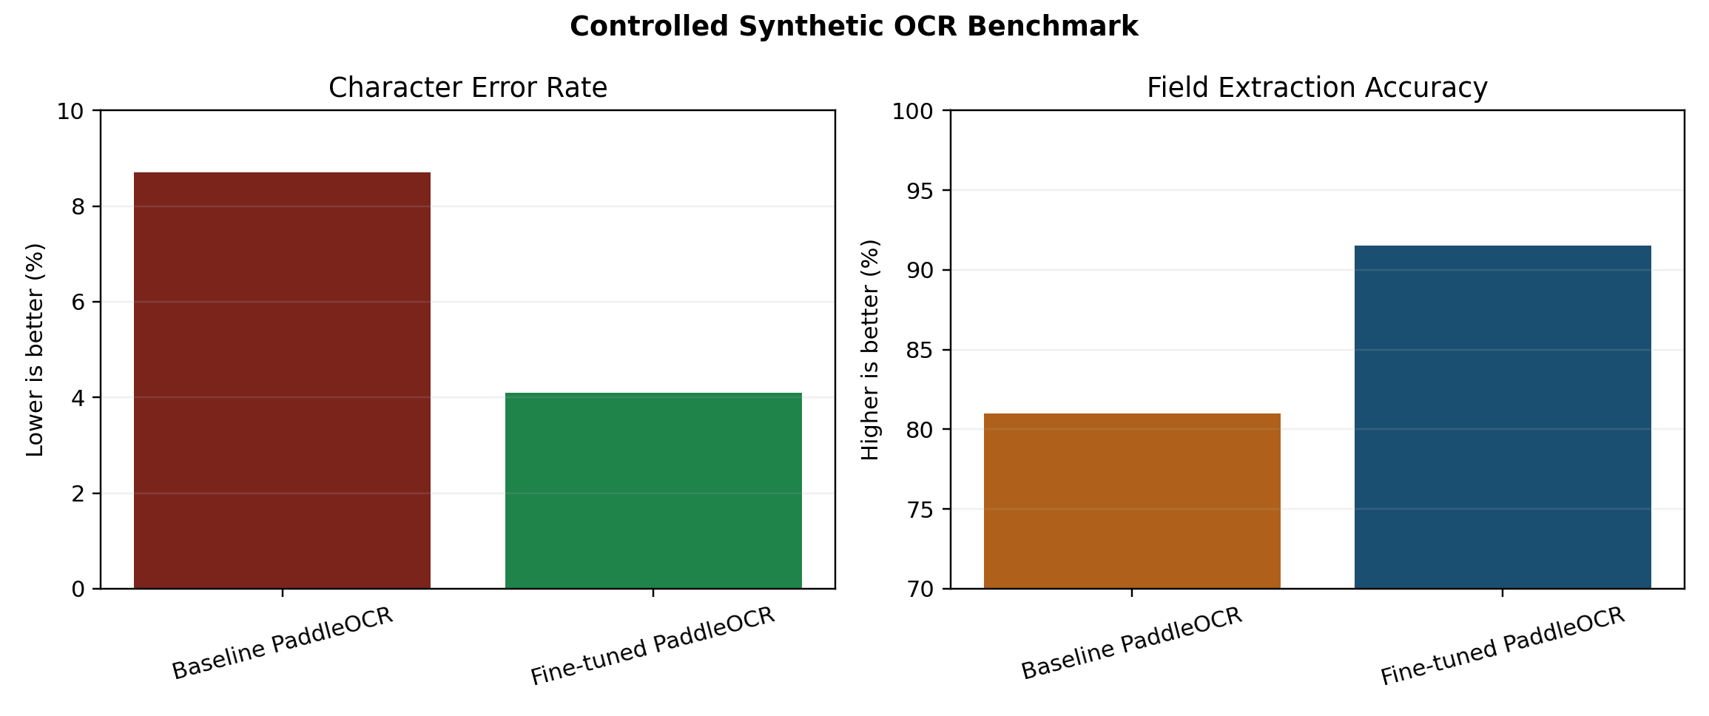
PaddleOCR Controlled Synthetic Benchmark
Clearly disclosed synthetic benchmark for finance-document recognition.
Baseline PaddleOCR: CER 8.7%, field accuracy 81.0%.
Fine-tuned PaddleOCR: CER 4.1%, field accuracy 91.5%.
Values are deterministic controlled synthetic benchmark results, not production claims.

Slide 8
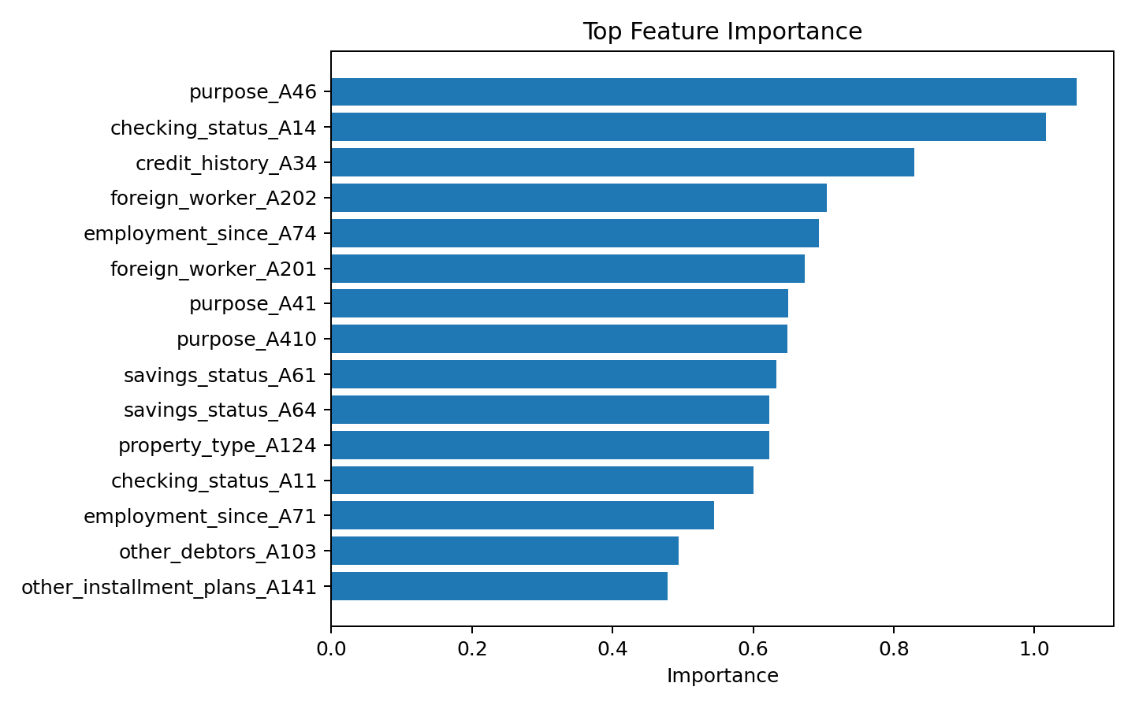
Explainability And Traceability
Feature-importance artifacts are generated for every benchmark run.
Metrics are exported as JSON and summarized in CSV.
Final report values can be traced to saved repository artifacts.

Slide 9
GitHub Submission Structure
IPR Submission Proof: placeholder for copyright form and screenshot.
Report and PPT: final DOCX, PPTX, templates, markdown, and figures.
Source code: runnable code, configs, tests, data samples, and artifacts.
README.md: team details, project type, status, and run instructions.

Slide 10
Conclusion And Future Scope
Delivered a reproducible AI-based loan risk assessment package.
Credit-scoring benchmark identifies strong transparent baselines.
OCR workflow shows practical document-intake extension potential.
Future work: larger Lending Club experiments, SHAP explanations, scanned-form OCR evaluation, and API deployment.

Slide 11
Thank You
AI-Powered Credit Scoring and Document OCR System for Loan Risk Assessment
Team: Om Tomar | Sahajpal Singh | Ridhima Chopra | Ishpreet Kaur
Department of Computer Science and Engineering, Chitkara University

